Slide 1
Data Prediction
Regression with Statsmodels in Python

Slide 2
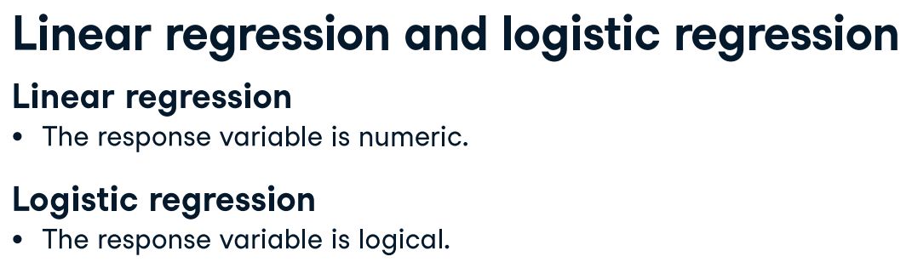
Python packages for regression
statsmodels
Optimized for insight
scikit-learn
Optimized for prediction
(numerical variable)
That is, it takes True or False values.
(categorial variable)

Slide 3
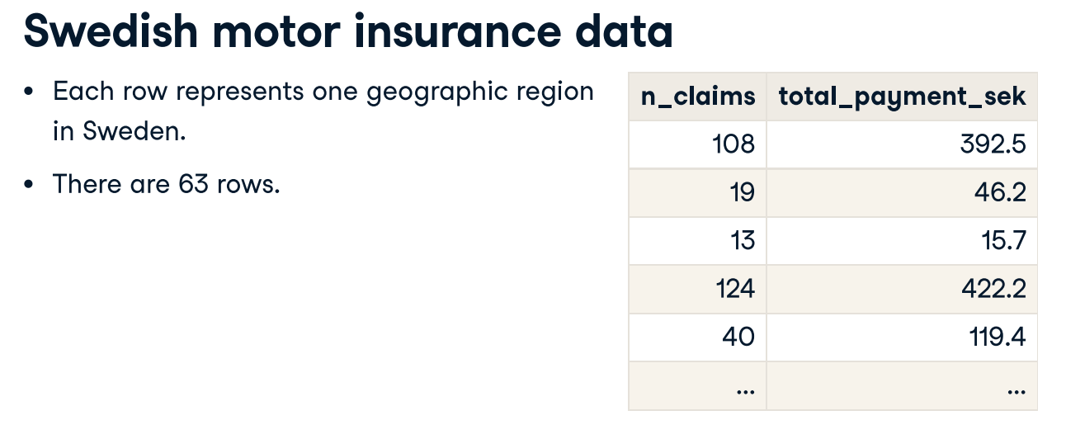
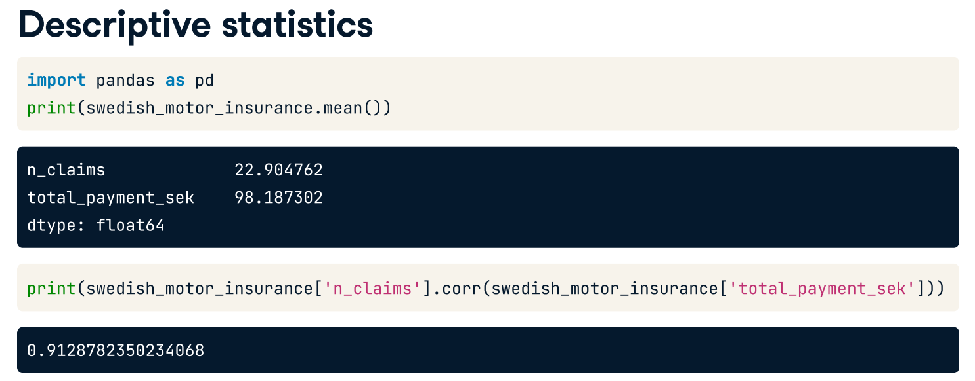

Slide 4
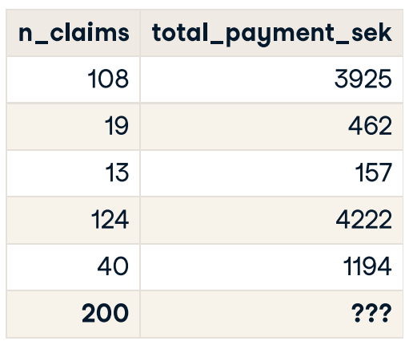
What is regression?
Statistical models to explore the relationship between a response variable and some explanatory variables.
Given values of explanatory variables, you can predict the values of the response variable.
Response variable (a.k.a. dependent variable) The variable that you want to predict.
Explanatory variables (a.k.a. independent variables) The variables that explain how the response variable will change.

Slide 5
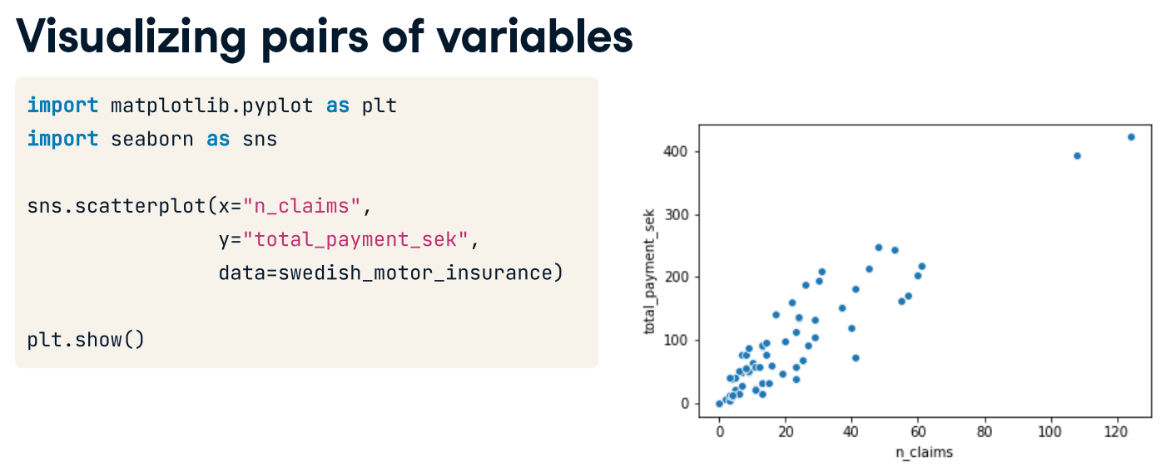
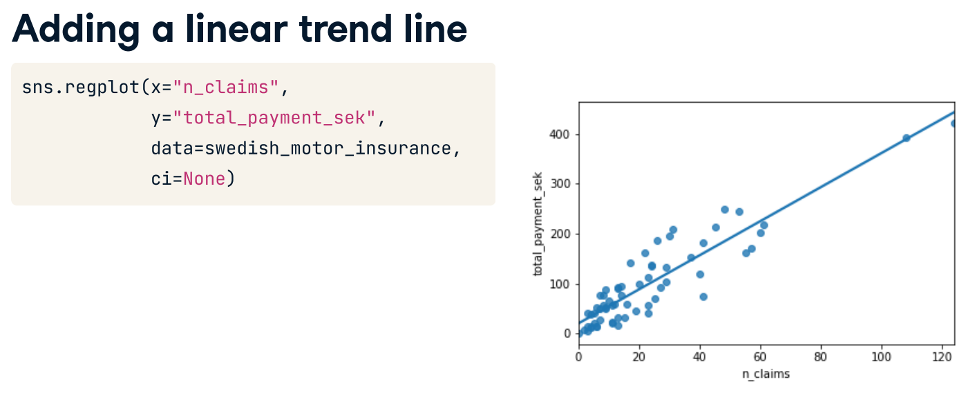

Slide 6
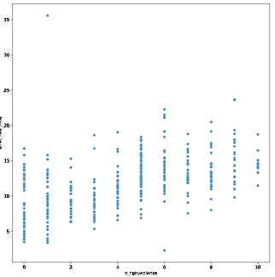
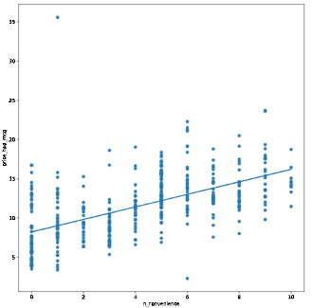
Visualizing two numeric variables
Before you can run any statistical models, it's usually a good idea to visualize your dataset. Here, you'll look at the relationship between house price per area and the number of nearby convenience stores using the Taiwan real estate dataset.
One challenge in this dataset is that the number of convenience stores contains integer data, causing points to overlap. To solve this, you will make the points transparent.
taiwan_real_estate is available from Taiwan_real_estate2.csv
Import the seaborn and matplotlib packages
Using taiwan_real_estate, draw a scatter plot of "price_twd_msq" (y-axis) versus "n_convenience" (x-axis).
Draw a trend line calculated using linear regression
Note: The scatter_kws argument in regplot, scatter_kws={'alpha': 0.5}, makes the data points 50% transparent.
taiwan_real_estate = pd.read_csv('Taiwan_real_estate2.csv’)
sns.scatterplot(x = 'n_convenience', y = 'price_twd_msq', data = taiwan_real_estate)
sns.regplot(x = 'n_convenience', y = 'price_twd_msq', data = taiwan_real_estate, ci= None, scatter_kws = {'alpha':0.5})

Slide 7
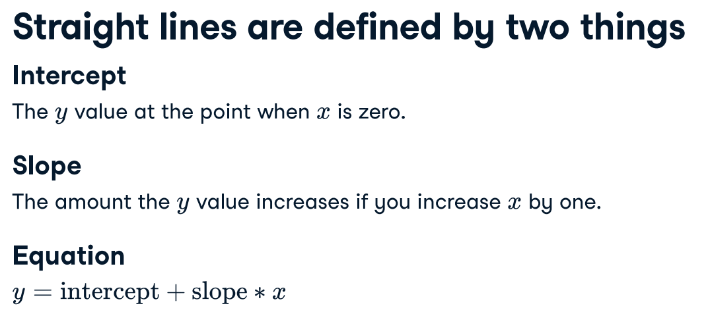
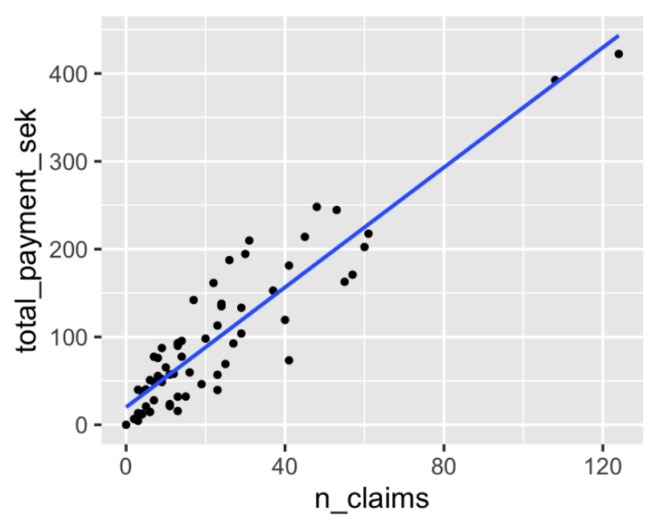
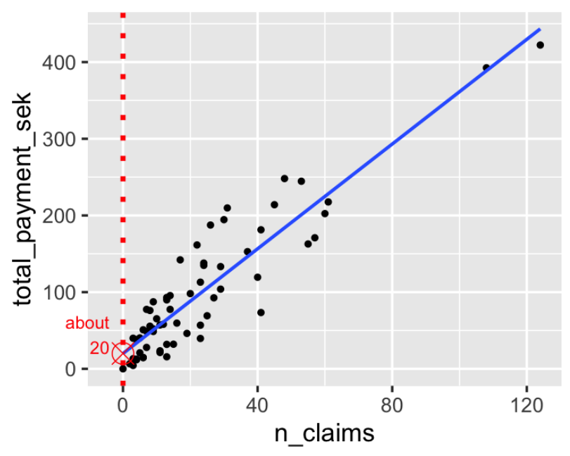
y = ?, when x is 140
y = ?, when x is 130
130
140

Slide 8
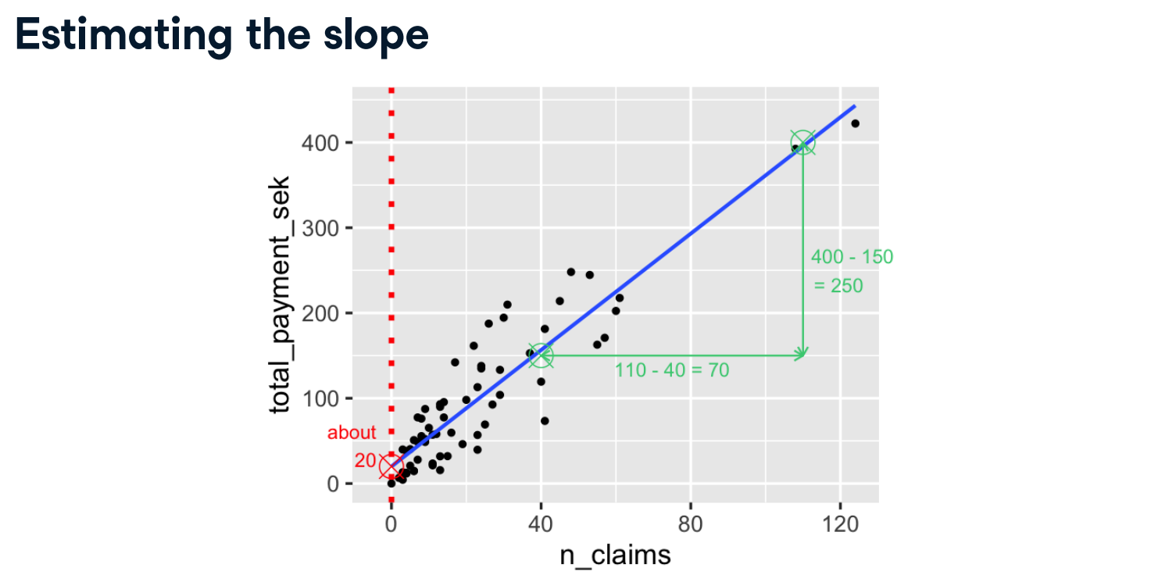
x2, y2
110, 400
x1, y1
40, 150

Slide 9
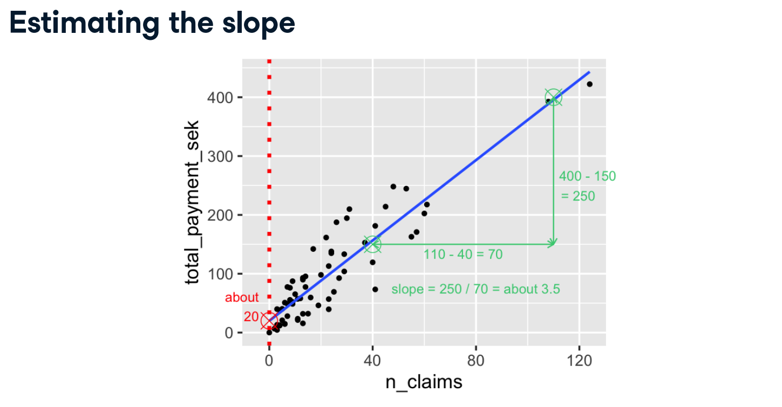
Slope = (y2 – y1) / (x2 – x1)

Slide 10
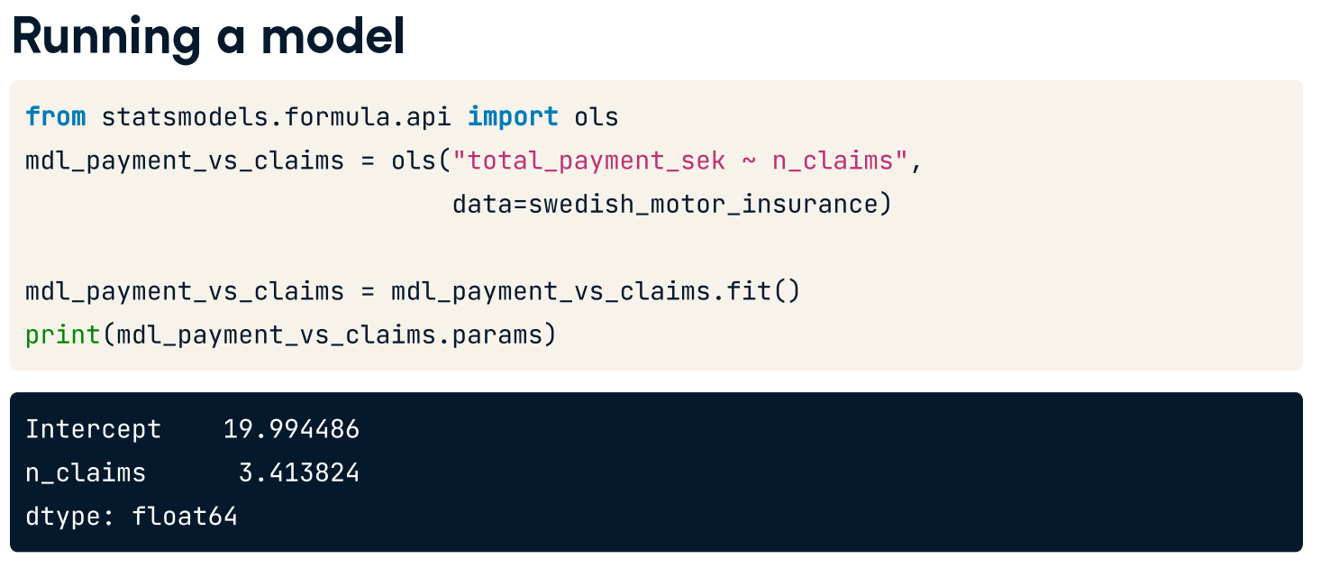
from statsmodels.formula.api import ols
mdl_payment_vs_claims = ols('total_payment_sek ~ n_claims', data = swedish_motor_insurance)
mdl_payment_vs_claims = mdl_payment_vs_claims.fit()
print(mdl_payment_vs_claims.params)
ols = ordinary least squares – a type of linear least squares method for choosing unknown parameters in a linear regression model.

Slide 11
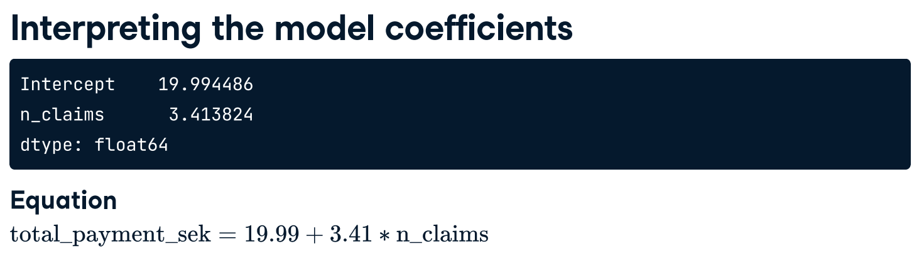
(y = response variable)
(x = explanatory variable)

Slide 12
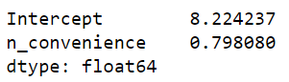
Linear regression with ols()
While sns.regplot() can display a linear regression trend line, it doesn't give you access to the intercept and slope as variables, or allow you to work with the model results as variables. That means that sometimes you'll need to run a linear regression yourself.
Time to run your first model!
taiwan_real_estate is available. TWD is an abbreviation for Taiwan dollars.
Import the ols() function from the statsmodels.formula.api package.
Run a linear regression with price_twd_msq as the response variable, n_convenience as the explanatory variable, and taiwan_real_estate as the dataset. Name it mdl_price_vs_conv.
Fit the model.
Print the parameters of the fitted model.
# Import the ols function
from statsmodels.formula.api import ols
taiwan_real_estate = pd.read_csv('Taiwan_real_estate2.csv’)
# Create the model object
mdl_price_vs_conv = ols('price_twd_msq ~ n_convenience', data=taiwan_real_estate)
# Fit the model
mdl_price_vs_conv = mdl_price_vs_conv.fit()
# Print the parameters of the fitted model
print(mdl_price_vs_conv.params)
y
x

Slide 13
Question
The model had an Intercept coefficient of 8.2242. What does this mean?
On average, houses had a price of 8.2242 TWD per sqr.m.
On average, a house with zero convenience stores nearby had a price of 8.2242 TWD per sqr.m.
The minimum house price was 8.2242 TWD per sqr.m.
The minimum house price with zero convenience stores nearby was 8.2242 TWD per sqr.m.
The intercept tells you nothing about house prices
Question
The model had an n_convenience coefficient of 0.7981. What does this mean?
If you increase the number of nearby convenience stores by one, then the expected increase in house price is 0.7981 TWD per sqr.m.
If you increase the house price by 0.7981 TWD per sqr.m., then the expected increase in the number of nearby convenience stores is one.
If you increase the number of nearby convenience stores by 0.7981, then the expected increase in house price is one TWD per sqr.m.
If you increase the house price by one TWD per sqr.m., then the expected increase in the number of nearby convenience stores is 0.7981
The n_convenience coefficient tells you nothing about house prices.

Slide 14
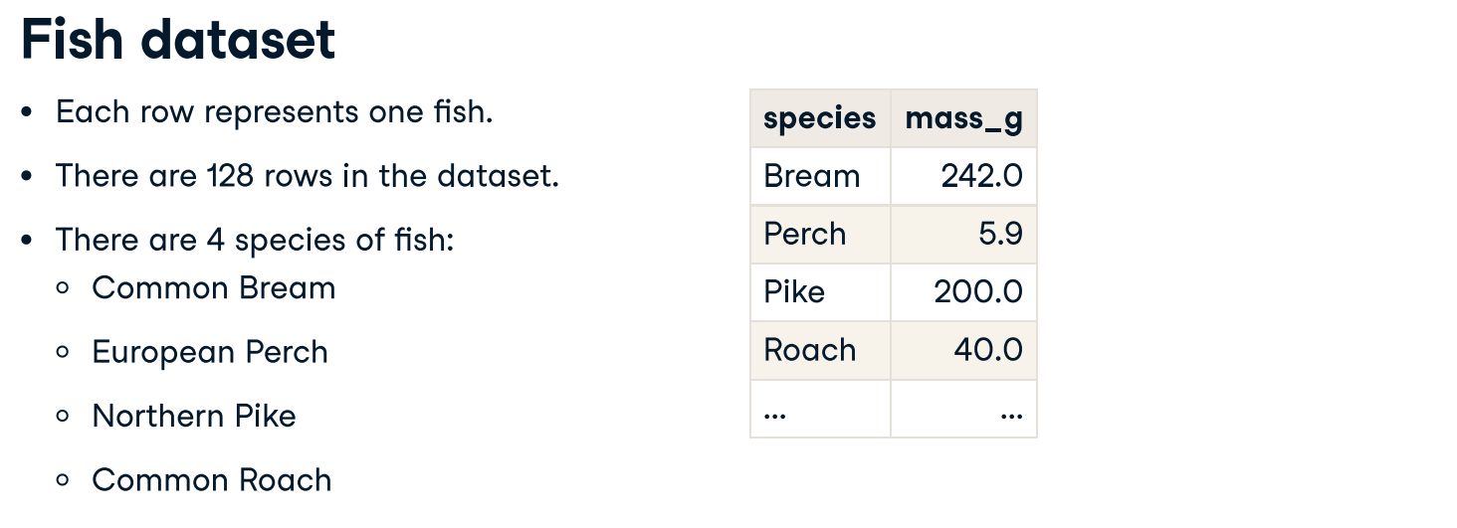
Categorial explanatory variables
fish.csv

Slide 15
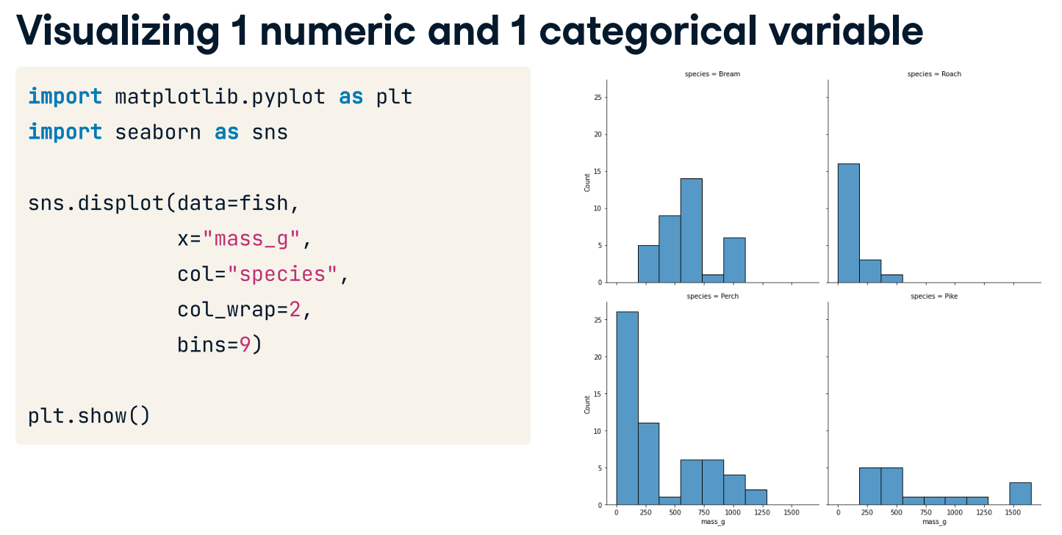
Plot histogram using displot in seaborn.
#Categorial explanatory variables - Fish data set
fish = pd.read_csv('fish.csv’)
sns.displot(data = fish, x = 'mass_g', col = 'species', col_wrap = 2, bins = 9)
plt.show()

Slide 16
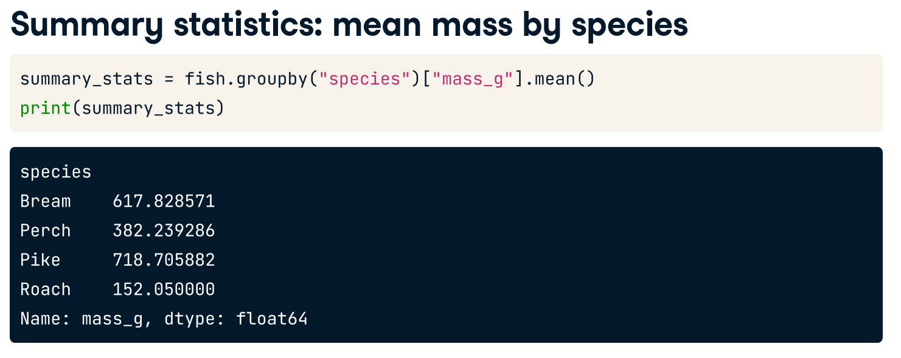
You can see that the mean mass of a bream is approximately six hundred and eighteen grams. The mean mass for a perch is three hundred and eighty-two grams, and so on.
summary_stats = fish.groupby('species')['mass_g'].mean()
print(summary_stats)

Slide 17
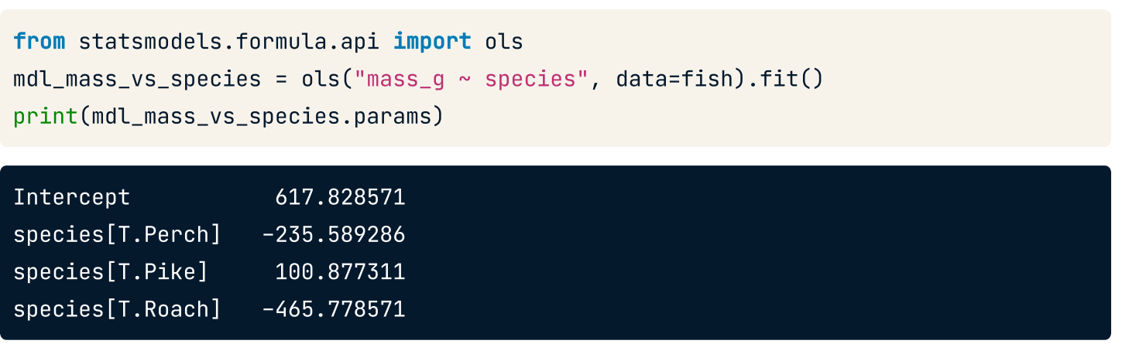
Let's run a linear regression using mass as the response variable and species as the explanatory variable. The syntax is the same: you call ols(), passing a formula with the response variable on the left and the explanatory variable on the right, and setting the data argument to the DataFrame. We fit the model using the fit method and retrieve the parameters using .params on the fitted model.
=> 617.828 + (– 235.589) = 382.239286
=> 617.828 + 100.877= 718.706
This time we have four values: an intercept, and one coefficient for three of the fish species. A coefficient for bream is missing, but the number for the intercept looks familiar. The intercept is the mean mass of the bream that you just calculated.

Slide 18
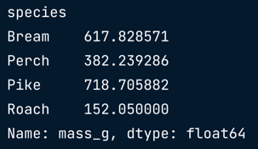
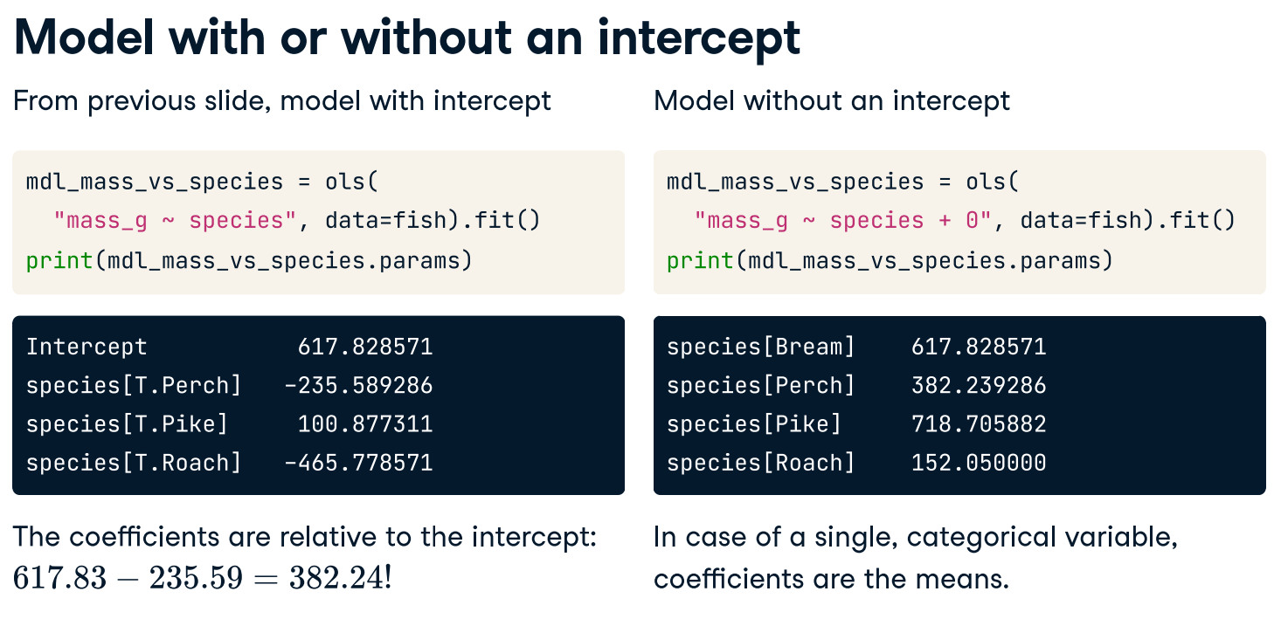
mdl_mass_vs_species = ols('mass_g ~ species + 0', data = fish).fit()print(mdl_mass_vs_species.params)

Slide 19
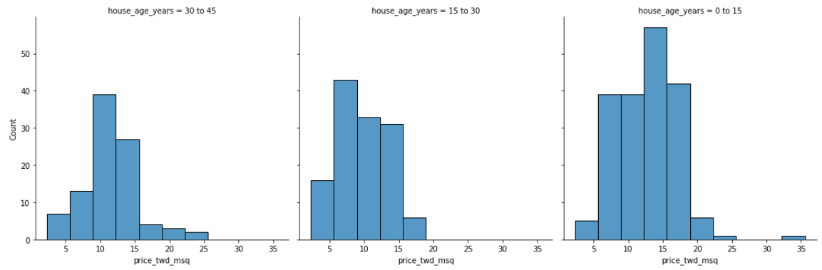
Visualizing numeric vs. categorical
If the explanatory variable is categorical, the scatter plot that you used before to visualize the data doesn't make sense. Instead, a good option is to draw a histogram for each category.
The Taiwan real estate dataset has a categorical variable in the form of the age of each house. The ages have been split into 3 groups: 0 to 15 years, 15 to 30 years, and 30 to 45 years.
taiwan_real_estate is considered in this exercise.
Using taiwan_real_estate, plot a histogram of price_twd_msq with 10 bins. Split the plot by house_age_years to give 3 panels.
# Histograms of price_twd_msq with 10 bins, split by the age of each house
sns.displot(data=taiwan_real_estate,
x='price_twd_msq',
col='house_age_years',
bins=10)
# Show the plot
plt.show()

Slide 20
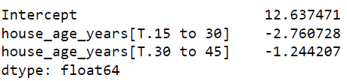
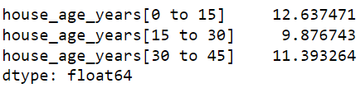
Group taiwan_real_estate by house_age_years and calculate the mean price (price_twd_msq) for each age group. Assign the result to mean_price_by_age.
Print the result and inspect the output.
To run a linear regression model with categorical explanatory variables, you can use the same code as with numeric explanatory variables. The coefficients returned by the model are different, however. Here you'll run a linear regression on the Taiwan real estate dataset.
Run and fit a linear regression with price_twd_msq as the response variable, house_age_years as the explanatory variable, and taiwan_real_estate as the dataset. Assign to mdl_price_vs_age.
Print its parameters.
Update the model formula so that no intercept is included in the model. Assign to mdl_price_vs_age0.
Print its parameters.
# Create the model, fit it
mdl_price_vs_age = ols('price_twd_msq ~ house_age_years', data=taiwan_real_estate).fit()
# Print the parameters of the fitted model
print(mdl_price_vs_age.params)
# Update the model formula to remove the intercept
mdl_price_vs_age0 = ols("price_twd_msq ~ house_age_years + 0", data=taiwan_real_estate).fit()
# Print the parameters of the fitted model
print(mdl_price_vs_age0.params)

Slide 21
Making Predictions

Slide 22
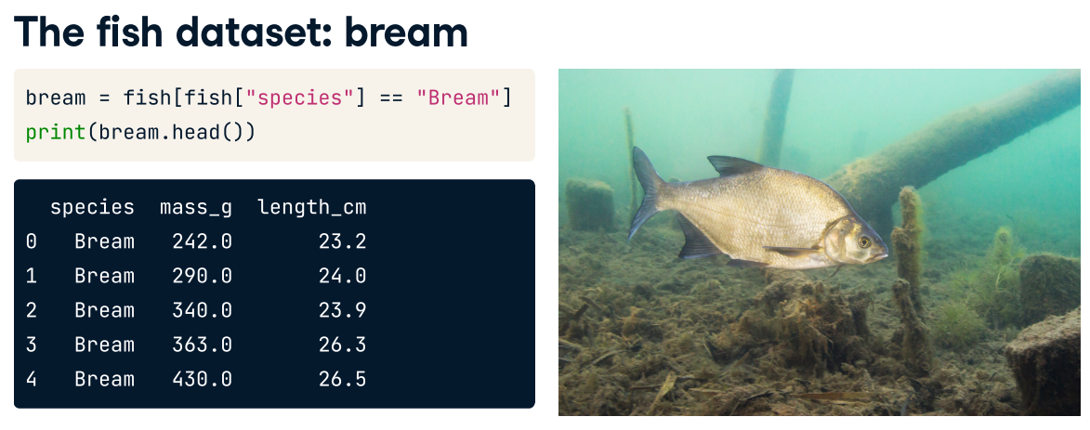
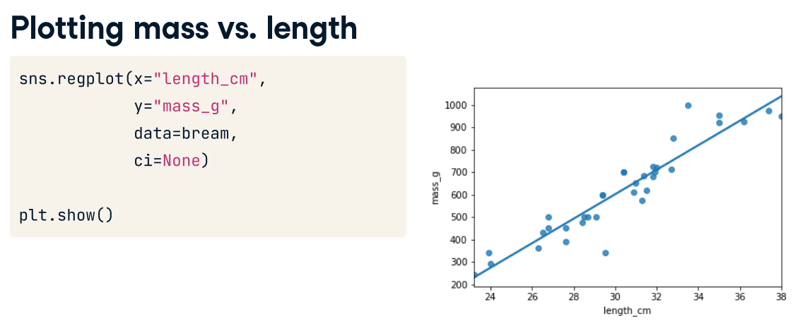
bream = fish[fish['species'] == 'Bream’]
print(bream.head())
This time, we'll look only at the bream data. There's a new explanatory variable too: the length of each fish, which we'll use to predict the mass of the fish.
sns.regplot(x='length_cm', y='mass_g', data=bream, ci=None)
plt.show()

Slide 23
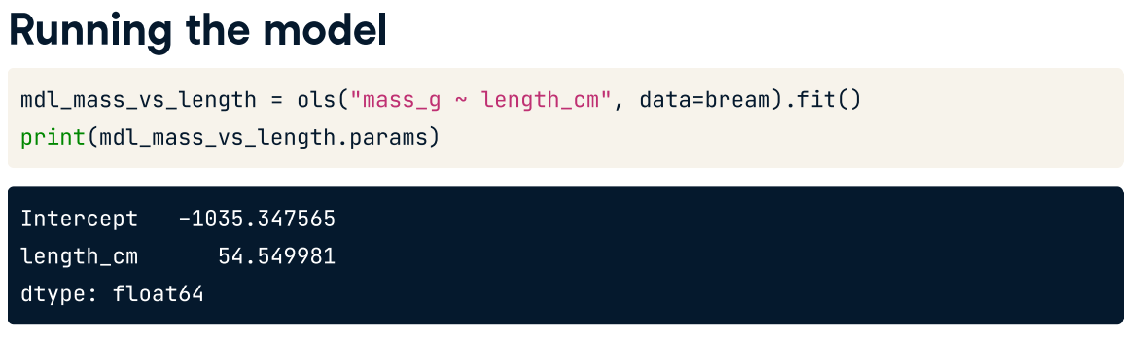
Before we can make predictions, we need a fitted model. As before, we call ols with a formula and the dataset, after which we add .fit(). The response, mass in grams, goes on the left-hand side of the formula, and the explanatory variable, length in centimeters, goes on the right.
We need to assign the result to a variable to reuse later on. To view the coefficients of the model, we use the .params attribute.
mdl_mass_vs_length = ols('mass_g ~ length_cm', data = bream).fit()
print(mdl_mass_vs_length.params)

Slide 24
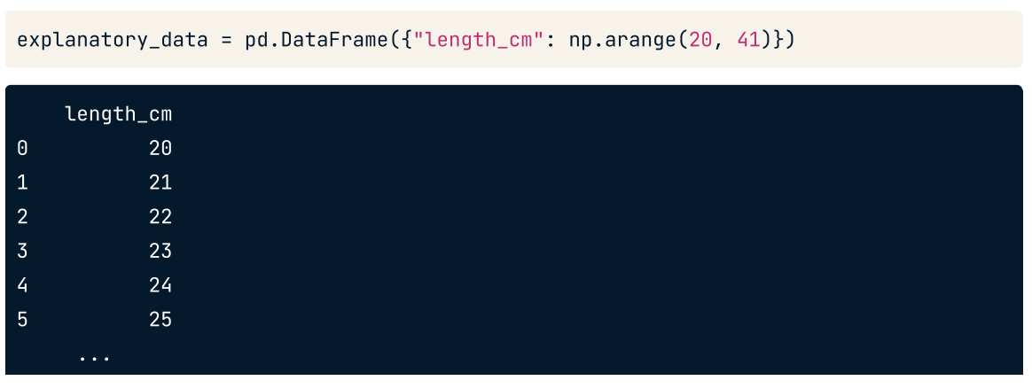
Data on explanatory values to predict
If I set the explanatory variables to these values, what value would be the response variable have?

Slide 25
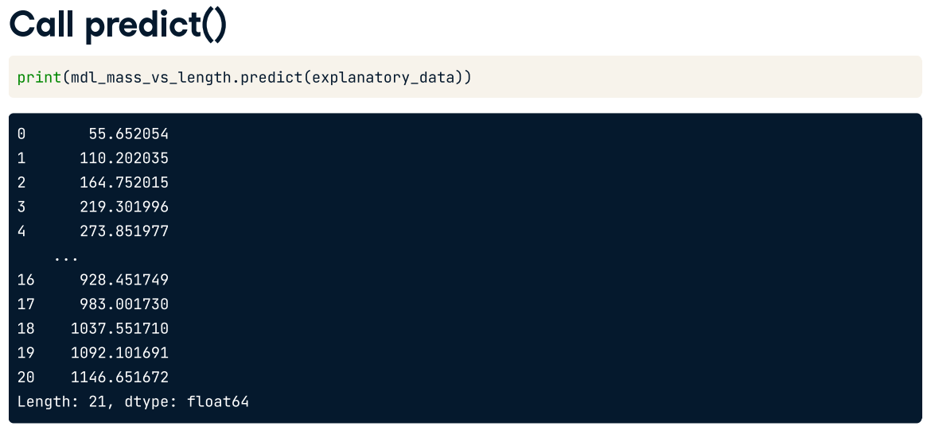
To predict the values, the next step is to call predict on the model, passing the DataFrame of explanatory variables as the argument. The predict function returns a Series of predictions, one for each row of the explanatory data.

Slide 26
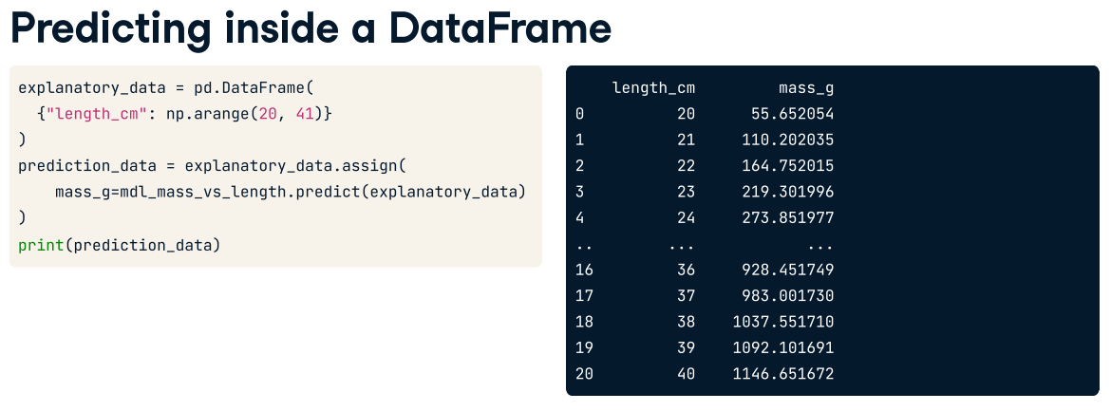
Having a single column of predictions isn't that helpful to work with. It's easier to work with if the predictions are in a DataFrame alongside the explanatory variables. To do this, you can use the pandas assign method. It returns a new object with all original columns in addition to new ones.
You start with the existing column, explanatory_data. Then, you use .assign to add a new column, named after the response variable, mass_g. You calculate it with the same predict code from the previous slide. The resulting DataFrame contains both the explanatory variable and the predicted response.
Now we can answer questions like "how heavy would we expect a bream with length twenty-three centimeters to be?", even though the original dataset didn't include a bream of that exact length. Looking at the prediction data, you can see that the predicted mass is two hundred and nineteen grams.
explanatory_data = pd.DataFrame({'length_cm':np.arange(20,41)})
prediction_data = explanatory_data.assign(mass_g = mdl_mass_vs_length.predict(explanatory_data))
print(prediction_data)

Slide 27
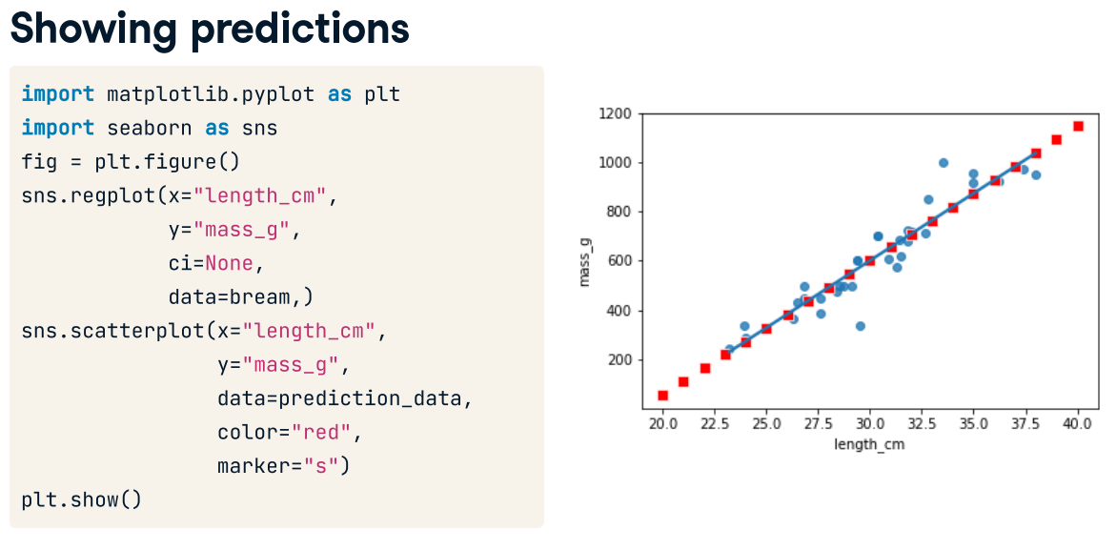
fig = plt.figure
sns.regplot(x='length_cm', y='mass_g', ci=None, data=bream)
sns.scatterplot(x='length_cm', y='mass_g',data=prediction_data, color='red', marker='s')
plt.show()

Slide 28
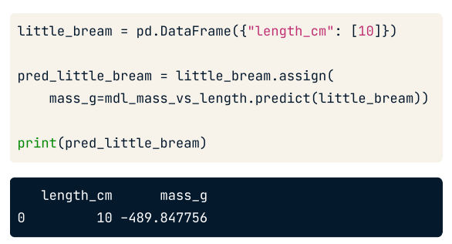
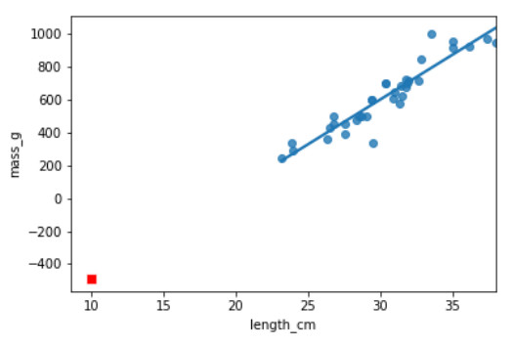
Extrapolating
Extrapolating means making predictions outside the range of observed data.
#Extraploating - prediction outside the range of observed data
little_bream = pd.DataFrame({'length_cm':[10]})
pred_little_bream = little_bream.assign(mass_g = mdl_mass_vs_length.predict(little_bream))
print(pred_little_bream)

Slide 29
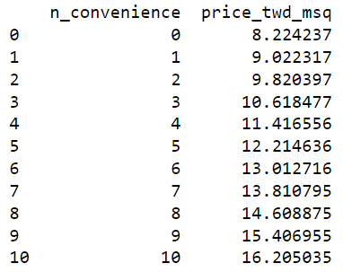
Predicting house prices
Perhaps the most useful feature of statistical models like linear regression is that you can make predictions. That is, you specify values for each of the explanatory variables, feed them to the model, and get a prediction for the corresponding response variable. Here, you'll make predictions for the house prices in the Taiwan real estate dataset.
Create a DataFrame of explanatory data, where the number of convenience stores, n_convenience, takes the integer values from zero to ten.
Print explanatory_data.
Use the model mdl_price_vs_conv to make predictions from explanatory_data and store it as price_twd_msq.
Print the predictions.
Create a DataFrame of predictions named prediction_data. Start with explanatory_data, then add an extra column, price_twd_msq, containing the predictions you created in the previous step.

Slide 30
# Create explanatory_data
explanatory_data = pd.DataFrame({'n_convenience': np.arange(0, 11)})
#print(explanatory_data)
# Use mdl_price_vs_conv to predict with explanatory_data, call it price_twd_msq
price_twd_msq = mdl_price_vs_conv.predict(explanatory_data)
#print(price_twd_msq)
# Create prediction_data
prediction_data = explanatory_data.assign(
price_twd_msq = price_twd_msq)
# Print the result
print(prediction_data)

Slide 31
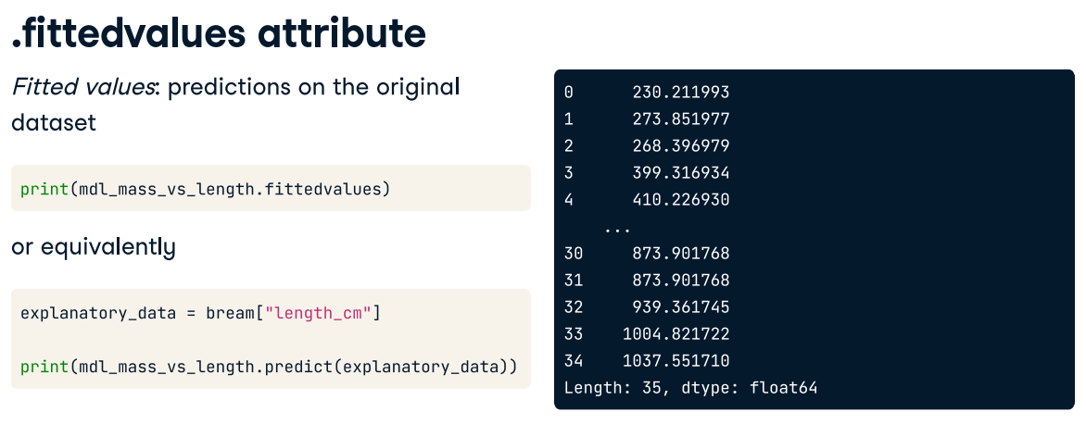

Slide 32
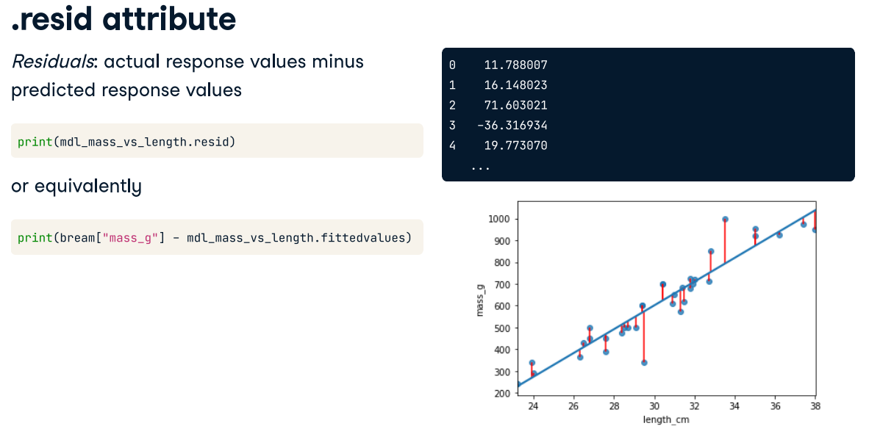
"Residuals" are a measure of inaccuracy in the model fit, and are accessed with the .resid attribute. Like fitted values, there is one residual for each row of the dataset. Each residual is the actual response value minus the predicted response value. In this case, the residuals are the masses of breams, minus the fitted values. Here we illustrated the residuals as red lines on the regression plot. Each vertical line represents a single residual.

Slide 33
Manually predicting house prices
You can manually calculate the predictions from the model coefficients. When making predictions in real life, it is better to use .predict(), but doing this manually is helpful to reassure yourself that predictions aren't magic - they are simply arithmetic.
In fact, for a simple linear regression, the predicted value is just the intercept plus the slope times the explanatory variable.
Here, explanatory_data is a number of convenience store from 0 to10.
Get the coefficients/parameters of mdl_price_vs_conv, assigning to coeffs.
Get the intercept, which is the first element of coeffs, assigning to intercept.
Get the slope, which is the second element of coeffs, assigning to slope.
Manually predict price_twd_msq using the formula, specifying the intercept, slope, and explanatory_data.
Run the code to compare your manually calculated predictions to the results from .predict().
coeffs = mdl_price_vs_conv.params
intercept = coeffs[0] # intercept = coeffs.iloc[0]
slope = coeffs[1] # slope = coeffs.iloc[1]
# Manually calculate the predictions
price_twd_msq = intercept + slope * explanatory_data
print(price_twd_msq)
# Use mdl_price_vs_conv to predict with explanatory_data, call it price_twd_msq
price_twd_msq = mdl_price_vs_conv.predict(explanatory_data)
# Create prediction_data
prediction_data = explanatory_data.assign(price_twd_msq = price_twd_msq)
# Print the result
print(prediction_data)

Slide 34
Transforming variables

Slide 35
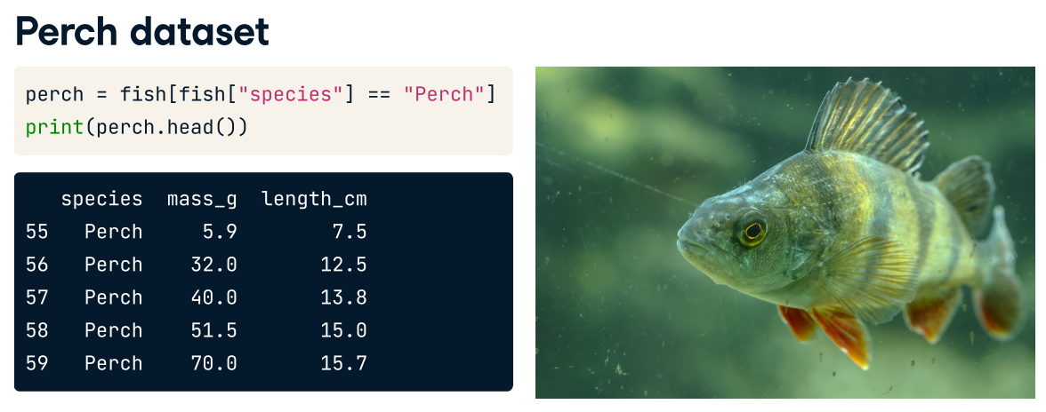
Transforming variables
perch = fish[fish['species']=='Perch’]
sns.regplot(x='length_cm', y='mass_g', data=perch,ci=None)
plt.show()
Sometimes, the relationship between the explanatory variable and the response variable may not be a straight line. To fit a linear regression model, you may need to transform the explanatory variable or the response variable, or both of them.

Slide 36
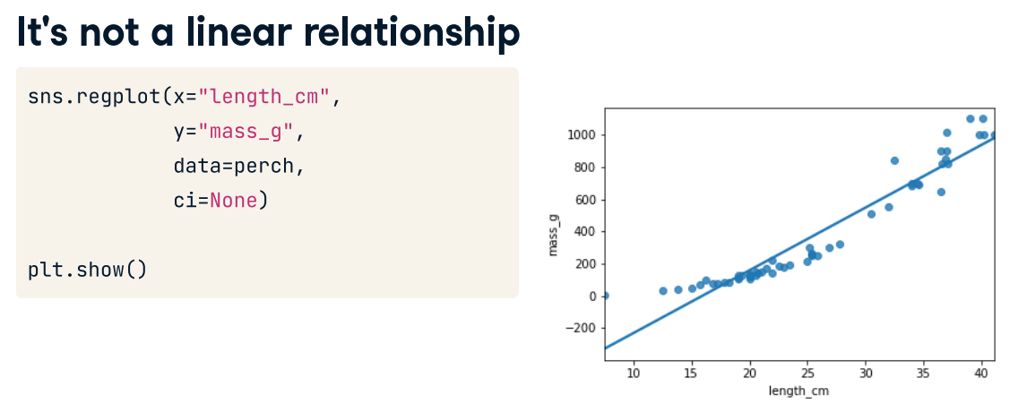

Slide 37

To understand why the bream had a strong linear relationship between mass and length, but the perch didn't, you need to understand your data. By looking at the picture of the bream on the left, it has a very narrow body. It is a guess that as bream get bigger, they mostly get longer and not wider. By contrast, the perch on the right has a round body, so it is a guess that as it grows, it gets fatter and taller as well as longer. Since the perches are growing in three directions at once, maybe the length cubed will give a better fit.

Slide 38
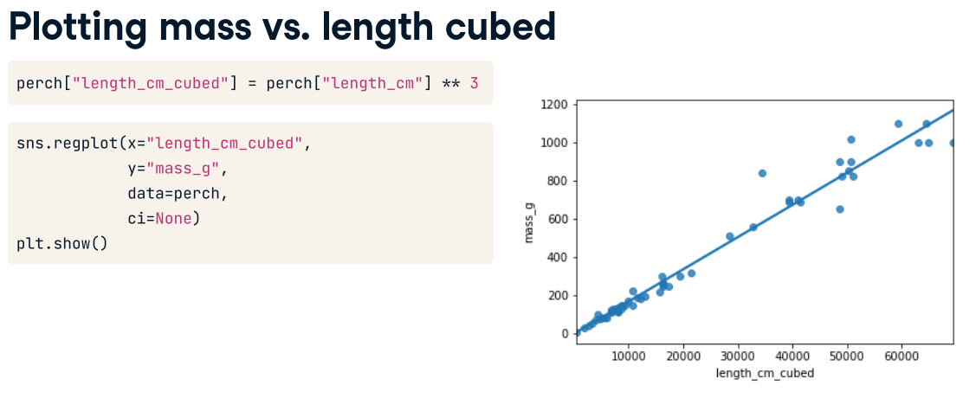
Here's an update to the previous plot. The only change is that the x-axis is now length to the power of three. To do this, first create an additional column where you calculate the length cubed. Then replace this newly created column in your regplot call. The data points fit the line much better now, so we're ready to run a model.
perch['length_cm_cubed'] = perch['length_cm'] ** 3
mdl_perch = ols('mass_g ~ length_cm_cubed', data=perch).fit()
mdl_perch.params

Slide 39
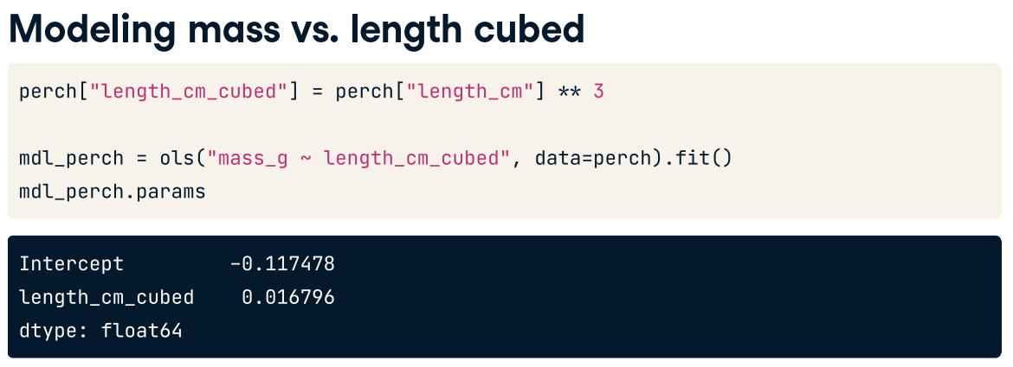
To model this transformation, we replace the original length variable with the cubed length variable. We then fit the model and extract its coefficients.
perch['length_cm_cubed'] = perch['length_cm'] ** 3
mdl_perch = ols('mass_g ~ length_cm_cubed', data=perch).fit()
mdl_perch.params

Slide 40
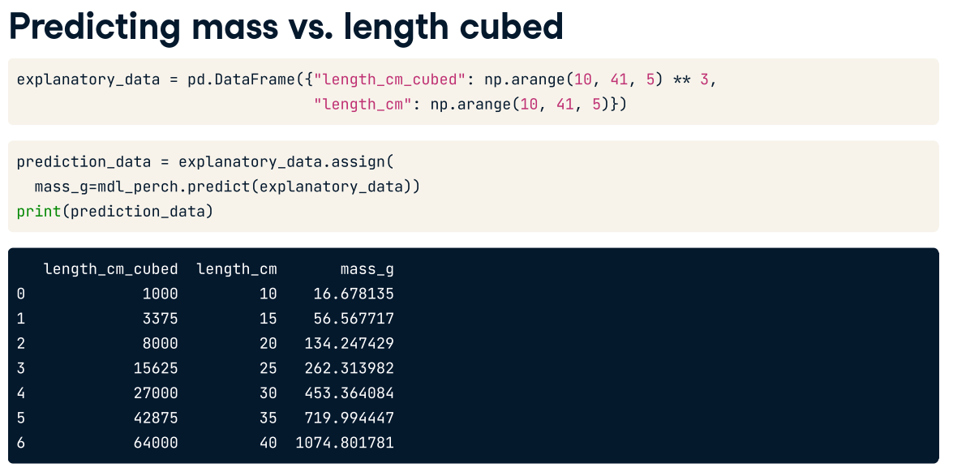
We create the explanatory DataFrame in the same way as usual. Notice that you specify the lengths cubed. We can also add the untransformed lengths column for reference. The code for adding predictions is the same assign and predict combination as you've seen before.
explanatory_data = pd.DataFrame({'length_cm_cubed':np.arange(10,41,5)**3, 'length_cm':np.arange(10,41,5)})
prediction_data = explanatory_data.assign(mass_g = mdl_perch.predict(explanatory_data))
print(prediction_data)

Slide 41
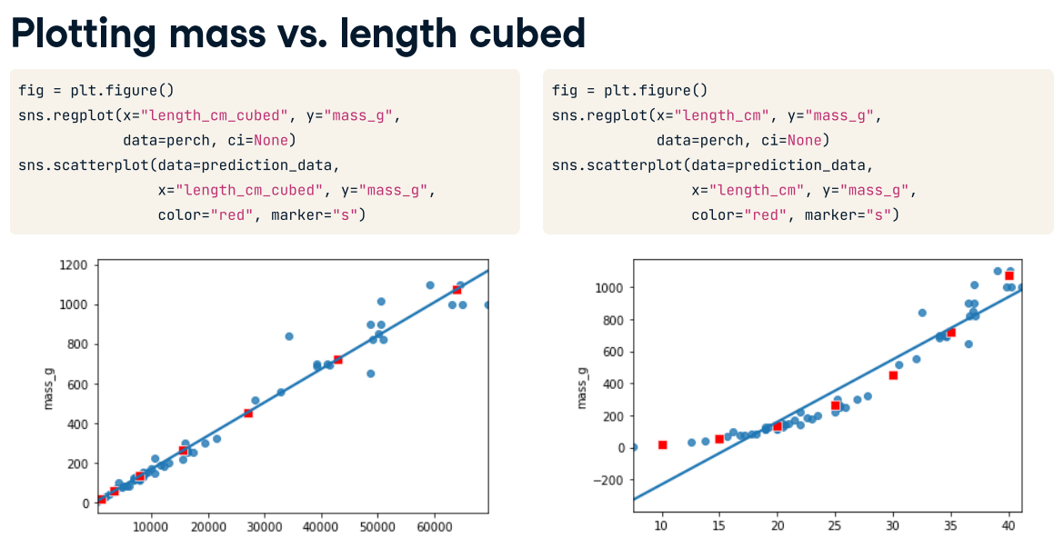
The predictions have been added to the plot of mass versus length cubed as red points. As you might expect, they follow the line drawn by regplot. It gets more interesting on the original x-axis. Notice how the red points curve upwards to follow the data. Your linear model has non-linear predictions, after the transformation is undone.
fig = plt.figure()
sns.regplot(x='length_cm_cubed’, y='mass_g',data=perch,ci=None)
sns.scatterplot(data=prediction_data, x='length_cm_cubed', y='mass_g', color='red', marker='s’)
plt.show()

Slide 42
perch = fish[fish['species'] == 'Perch']
print(perch.head())
sns.regplot(x='length_cm', y = 'mass_g', data = perch, ci=None)
plt.show()
perch['length_cm_cubed'] = perch['length_cm']**3
sns.regplot(x='length_cm_cubed', y = 'mass_g', data = perch, ci=None)
plt.show()
mdl_perch = ols('mass_g ~ length_cm_cubed', data=perch).fit()
print(mdl_perch.params)
explanatory_data = pd.DataFrame({'length_cm_cubed': np.arange(10,41,5)**3,
'length_cm': np.arange(10,41,5)})
prediction_data = explanatory_data.assign(mass_g=mdl_perch.predict(explanatory_data))
print(prediction_data)
fig = plt.figure()
sns.regplot(x='length_cm_cubed', y = 'mass_g', data = perch, ci=None)
sns.scatterplot(data=prediction_data, x = 'length_cm_cubed', y = 'mass_g’, color='red', marker='s')
plt.show()

Slide 43
Transforming the explanatory variable
If there is no straight-line relationship between the response variable and the explanatory variable, it is sometimes possible to create one by transforming one or both of the variables. Here, you'll look at transforming the explanatory variable.
You'll take another look at the Taiwan real estate dataset, this time using the distance to the nearest MRT (metro) station as the explanatory variable. You'll use code to make every commuter's dream come true: shortening the distance to the metro station by taking the square root.
Look at the regplot (dist_to_mrt_m vs price_twd_msq).
Add a new column to taiwan_real_estate called sqrt_dist_to_mrt_m that contains the square root of dist_to_mrt_m.
Create the same scatter plot (with regplot) as the first one but use the new transformed variable on the x-axis instead.
Look at the new plot. Notice how the numbers on the x-axis have changed. This is a different line to what was shown before. Do the points track the line more closely?
sns.regplot(x="dist_to_mrt_m", y="price_twd_msq", data=taiwan_real_estate, ci=None)
plt.show()
# Create sqrt_dist_to_mrt_m
taiwan_real_estate["sqrt_dist_to_mrt_m"] = np.sqrt(taiwan_real_estate["dist_to_mrt_m"])
plt.figure()
# Plot using the transformed variable
sns.regplot(x="sqrt_dist_to_mrt_m", y="price_twd_msq", data=taiwan_real_estate, ci=None)
plt.show()

Slide 44
Run a linear regression of price_twd_msq versus the square root of dist_to_mrt_m using taiwan_real_estate.
Print the parameters.
# Run a linear regression of price_twd_msq vs. square root of dist_to_mrt_m using taiwan_real_estate
mdl_price_vs_dist = ols("price_twd_msq ~ sqrt_dist_to_mrt_m", data=taiwan_real_estate).fit()
# Print the parameters
print(mdl_price_vs_dist.params)
Create a DataFrame of predictions named prediction_data by adding a column of predictions called price_twd_msq to explanatory_data.
Predict using mdl_price_vs_dist and explanatory_data.
Print the predictions.
explanatory_data = pd.DataFrame({"sqrt_dist_to_mrt_m": np.sqrt(np.arange(0, 81, 10) ** 2),
"dist_to_mrt_m": np.arange(0, 81, 10) ** 2})
# Create prediction_data by adding a column of predictions to explantory_data
prediction_data = explanatory_data.assign(
price_twd_msq = mdl_price_vs_dist.predict(explanatory_data)
)
# Print the result
print(prediction_data)

Slide 45
Add a layer to your regplot containing points from prediction_data, colored "red". Both with squared root and original values.
fig = plt.figure()
sns.regplot(x="sqrt_dist_to_mrt_m", y="price_twd_msq", data=taiwan_real_estate, ci=None)
# Add a layer of your prediction points
sns.scatterplot(x="sqrt_dist_to_mrt_m", y="price_twd_msq", data=prediction_data, color="red")
plt.show()
fig = plt.figure()
sns.regplot(x="dist_to_mrt_m", y="price_twd_msq", data=taiwan_real_estate, ci=None)
# Add a layer of your prediction points
sns.scatterplot(x="dist_to_mrt_m", y="price_twd_msq", data=prediction_data, color="red")
plt.show()

Slide 46
Quantifying Model Fit
How good or bad model is

Slide 47
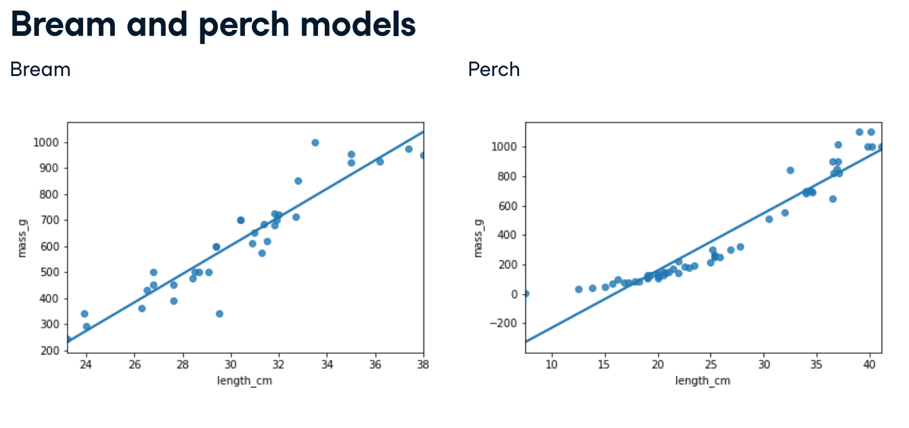

Slide 48
Coefficient of Determination
Sometimes called "r-squared" or "R-squared".
The proportion of the variance in the response variable that is predictable from the explanatory variable
1 means a perfect
0 means the worst possible

Slide 49
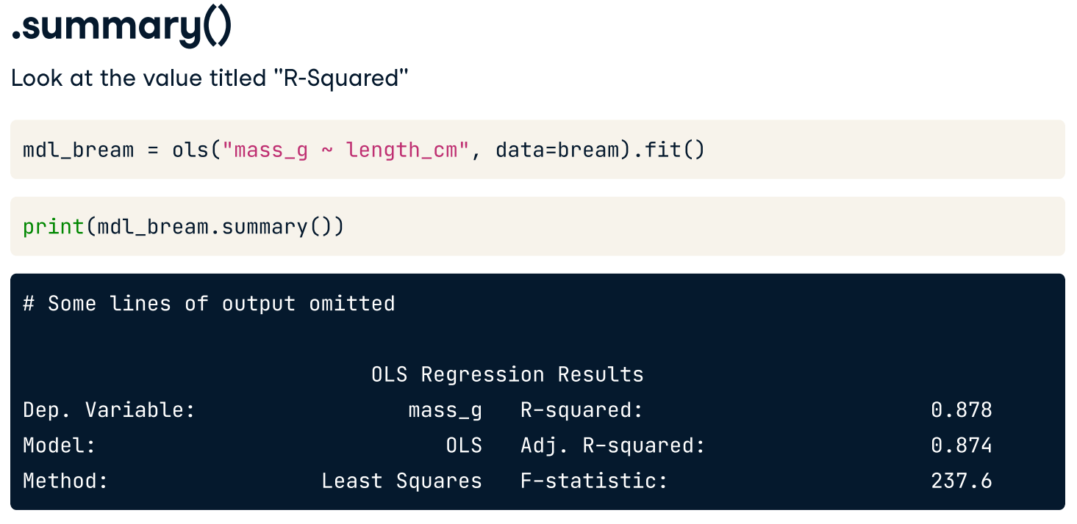
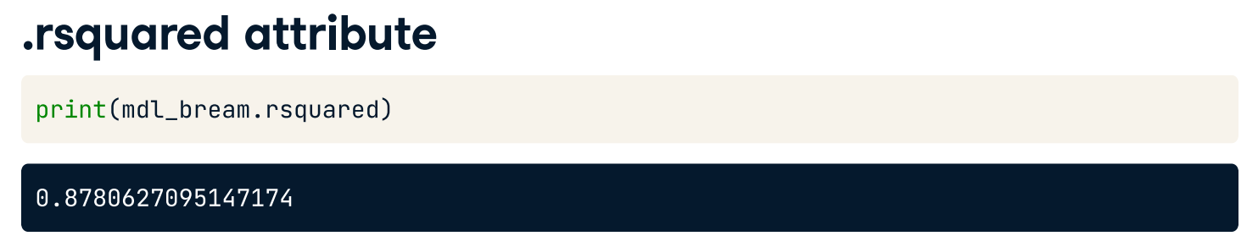

Slide 50
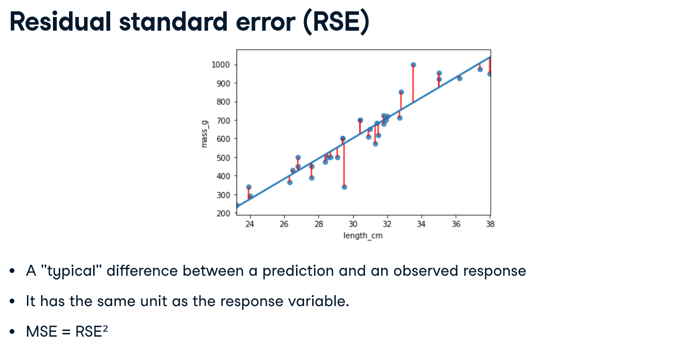

Slide 51
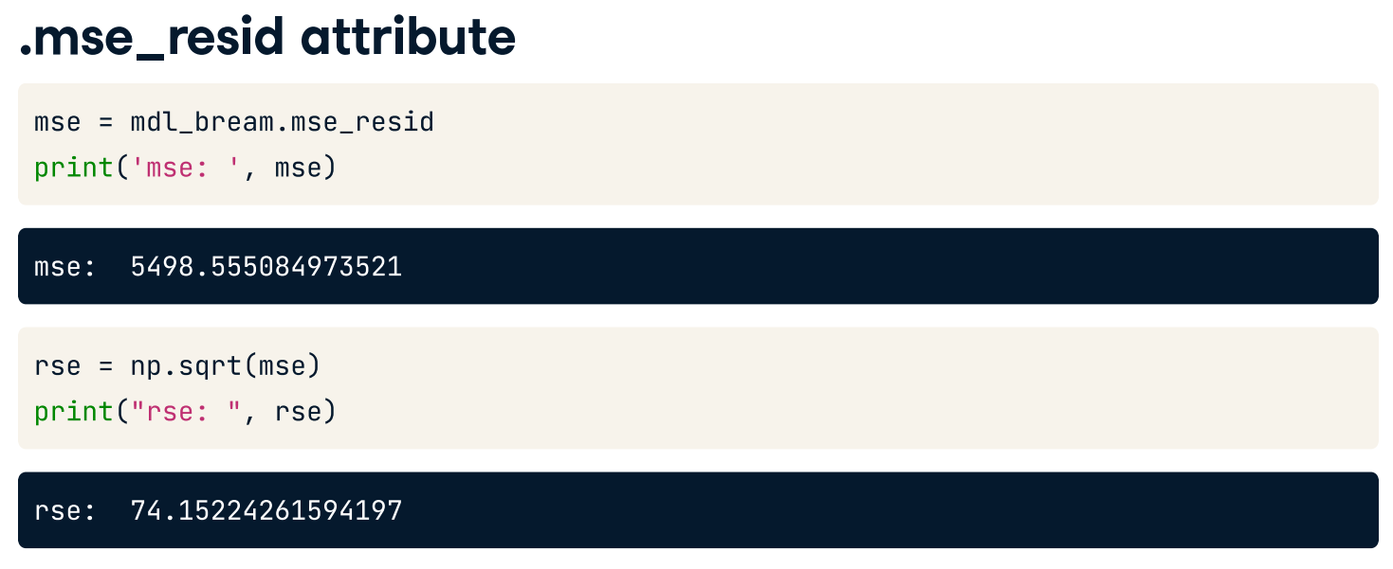
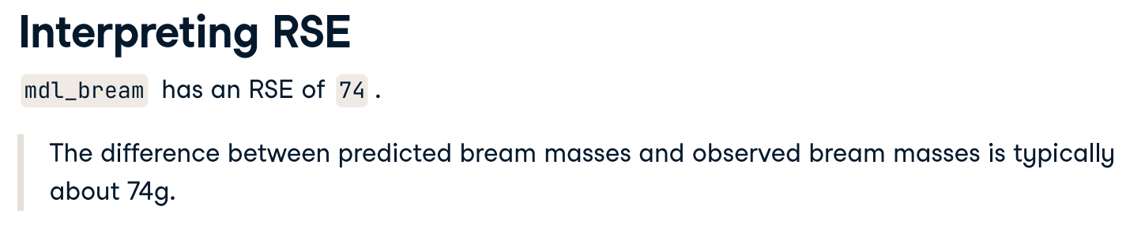

Slide 52
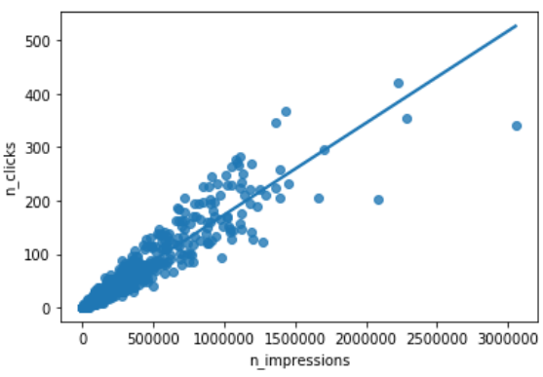

HOMEWORK – Mini Project # 1 (Deadline: Next Week)
Transforming both response and explanatory variables.
The response variable can be transformed too, but this means you need an extra step at the end to undo that transformation. That is, you "back transform" the predictions.
Here you will be working with data on the digital advertising workflow: spending money to buy ads, and counting how many people see them (the "impressions"). The next step is determining how many people click on the advert after seeing it.
ad_conversion can be loaded from ad_conversion.csv.
Complete the following tasks.
Look at the scatter plot (using regplot for n_impressions vs n_clicks)
Create a qdrt_n_impressions column using n_impressions raised to the power of 0.25.
Create a qdrt_n_clicks column using n_clicks raised to the power of 0.25.
Create a regression plot using the transformed variables. Do the points track the line more closely?

Slide 53



Run a linear regression of qdrt_n_clicks versus qdrt_n_impressions using ad_conversion and assign it to mdl_click_vs_impression.
Print the model parameters
Create explanatory data for predictions
qdrt_n_impressions (for a range of 0 to 3000000, with a step of 500000) raised to a power of 0.25
Also have n_impressions as a reference (no need to raise a power)
Then predict data for qdrt_n_clicks and assign it to prediction_data.
Print the prediction data.
Do scatter plot (using regplot) and add a layer of your prediction
points

Slide 54

Back transformation
Up until now, you transformed the response variable, ran a regression, and made predictions. But you're not done yet! In order to correctly interpret and visualize your predictions, you'll need to do a back-transformation.
From prediction_data, create n_clicks by raising qdrt_n_clicks to a power of 4
Edit the plot to add a layer of points from prediction_data (n_impressions vs. n_clicks), colored "red".
Determine whether this model is a good fit.
Also determine RSE and interpret the result.
Save your work with the following naming convention.
YourID_YourName_MiniProject1_LinearRegression.ipynb
You must submit both .ipynb.
Have your name and ID included in the first and the last cell of your Jupyter notebook.

